Slide 1

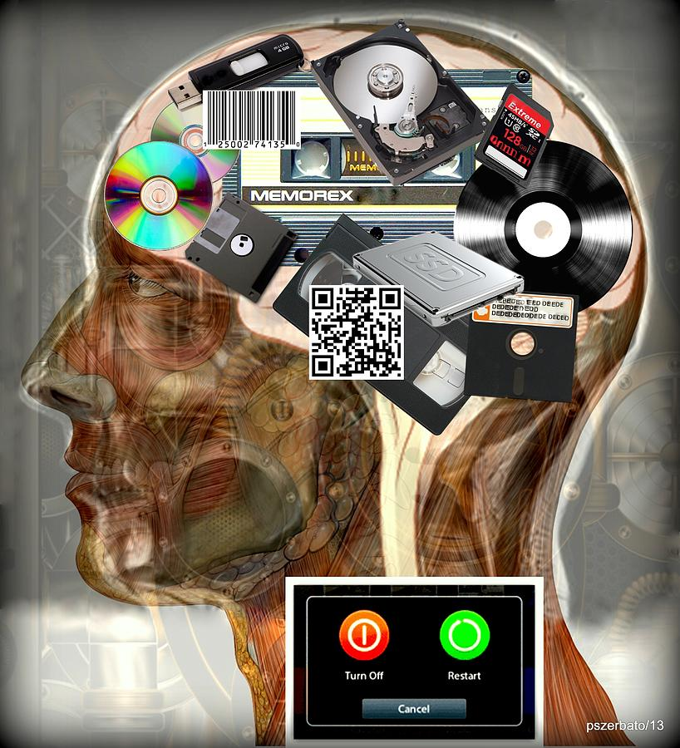
Introduction to Computer Science
Reichman University
Lecture 8-1
Multimedia, Part II
Notes:
‹#›

Slide 2
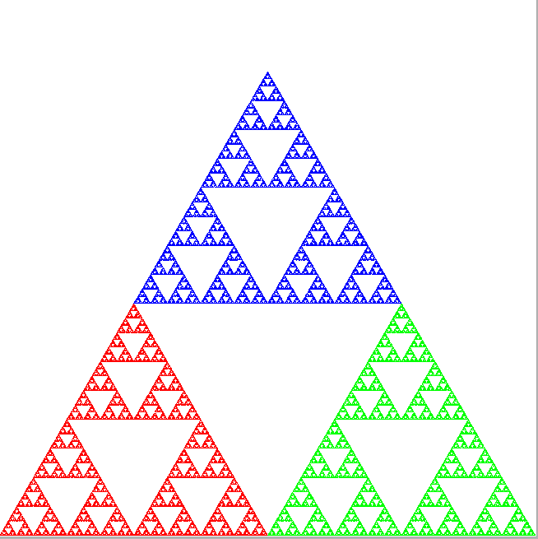
Lecture plan
Graphics
Animation
Sound

Slide 3
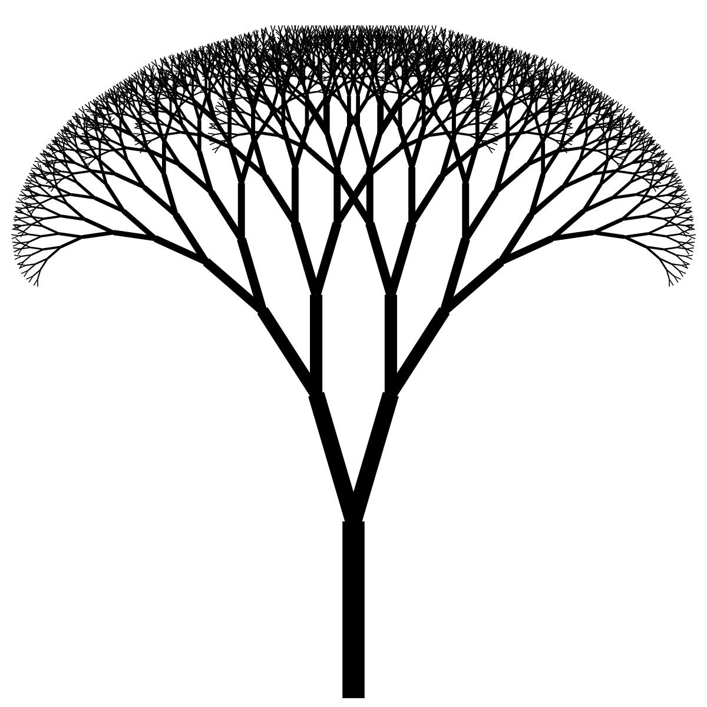
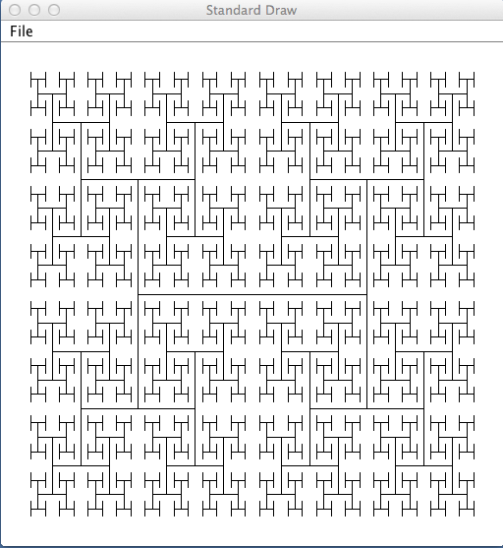
Fractals
Self-replicating patterns (lecture 7-1):

Slide 4
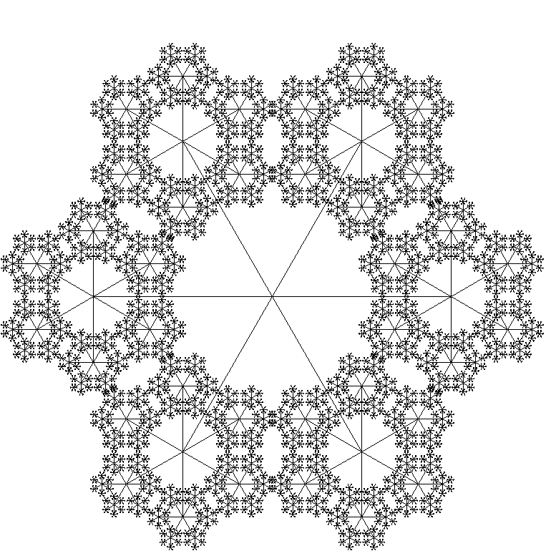
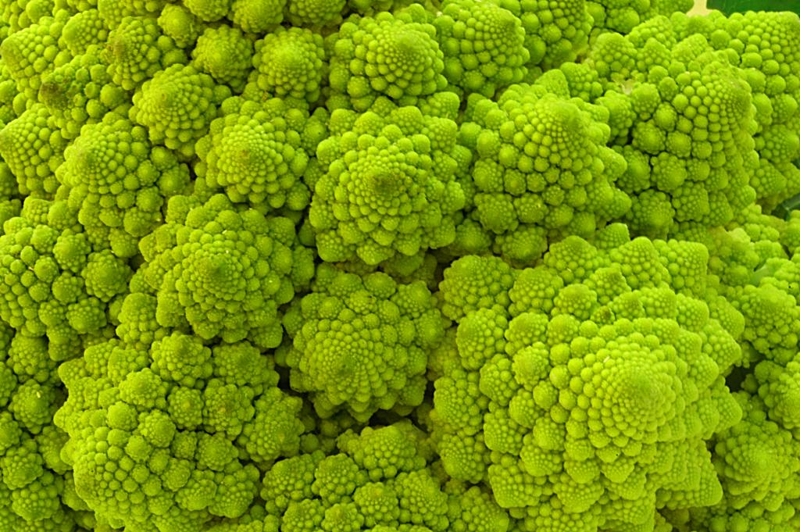
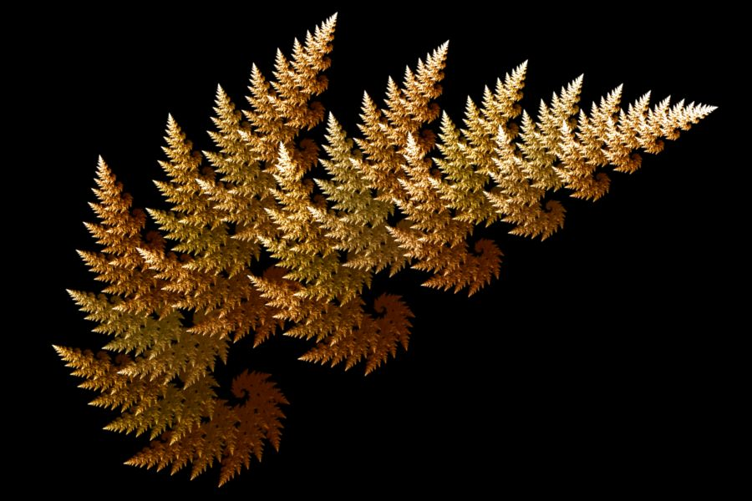
Fractals
Self-replicating patterns:
Fractal: The deeper you dive into the image, the more you see the same image.

Slide 5
Graphics: StdDraw API (partial)
static void circle(double x, double y, double radius)
static void clear()
static void enableDoubleBuffering()
static void filledCircle(x, y, radius);
static Color getBackgroundColor()
static Color getPenColor()
static void line(double x0, double y0, double x1, double y1)
static void pause(int t)
static void picture(double x, double y, String filename)
static void point(double x, double y)
static void rectangle(double x, double y, double halfWidth, double halfHeight)
static void save(String filename)
static void setCanvasSize(int canvasWidth, int canvasHeight)
static void setPenColor(int red, int green, int blue)
static void setPenColor(Color color)
static void setPenRadius(double radius)
static void setTitle(String title)
static void setXscale(double min, double max)
static void setYscale(double min, double max)
static void show()
static void square(double x, double y, double halfLength)
Complete API (click)
For the next example we’ll need only the point drawing function

Slide 6
Fractals
Sierpinski triangle:

Slide 7
Fractals
Sierpinski triangle:
Algorithm
Construct an equilateral triangle with vertices R, G, B;
currentPoint = R
repeat N times:
target = random point (R, G, or B)
compute the halfway point between the currentPoint and the target
draw this point using the chosen color
currentPoint = target
B
R
G

Slide 8
Fractals
Sierpinski triangle:
Algorithm
Construct an equilateral triangle with vertices R, G, B;
currentPoint = R
repeat N times:
target = random point (R, G, or B)
compute the halfway point between the currentPoint and the target
draw this point using the chosen color
currentPoint = target
B
2
5
1
3
6
7
4
8
9
0
R
G

Slide 9
Fractals
Sierpinski triangle:
Algorithm
Construct an equilateral triangle with vertices R, G, B;
currentPoint = R
repeat N times:
target = random point (R, G, or B)
compute the halfway point between the currentPoint and the target
draw this point using the chosen color
currentPoint = target
B
R
After N = 100000 iterations...
G

Slide 10
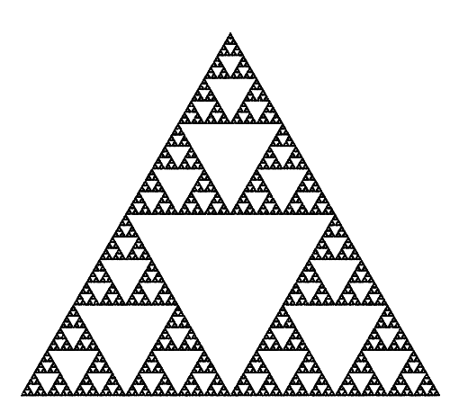
Fractals
Sierpinski triangle:
Algorithm
Construct an equilateral triangle with vertices 0, 1, 2;
currentPoint = 0
repeat N times:
target = random point (0, 1, or 2)
compute the halfway point between the currentPoint and the target
draw this point using the chosen color
currentPoint = target
% java Sierpinski 100000
2
0
1
Black and white version

Slide 11
Fractals
Sierpinski triangle:
Algorithm
Construct an equilateral triangle with vertices 0, 1, 2;
currentPoint = 0
repeat N times:
target = random point (0, 1, or 2)
compute the halfway point between the currentPoint and the target
draw this point using the chosen color
currentPoint = target
% java Sierpinski 100000
(½, ½√3)
(0, 0)
canvas = unit square
(1, 0)
xVertex = { 0.0, 1.0, 0.5 };
yVertex = { 0.0, 0.0, 0.866 };
0 1 2

Slide 12
Fractals
Sierpinski triangle:
public class Sierpinski {
public static void main(String[] args) {
// Gets the number of iterations
int N = Integer.parseInt(args[0]);
// Sets the coordinates of the triangle's vertices
double[] xVertex = { 0.0, 1.0, 0.5 };
double[] yVertex = { 0.0, 0.0, 0.866 };
double x = 0.0, y = 0.0;
for (int i = 0; i < N; i++) {
// Chooses a random index from (0, 1, 2),
// and draws the midpoint
int r = (int) (Math.random() * 3);
x = (x + xVertex[r]) / 2.0;
y = (y + yVertex[r]) / 2.0;
StdDraw.point(x, y);
}
}
}
% java Sierpinski 100000
(½, ½√3)
(0, 0)
canvas = unit square
(1, 0)
xVertex = { 0.0, 1.0, 0.5 };
yVertex = { 0.0, 0.0, 0.866 };
0 1 2

Slide 13
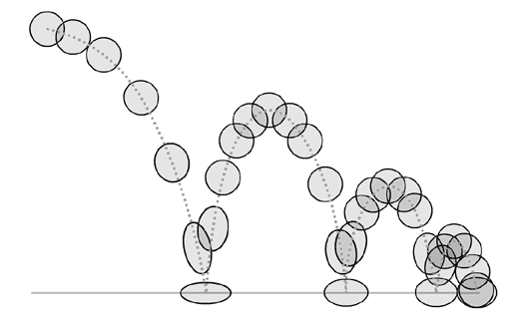
Lecture plan
Graphics
Animation
Sound

Slide 14

Bouncing ball
% java BouncingBall
Notes:
apply standard graphics technique to create the illusion of movement

Slide 15
Bouncing ball
Bouncing ball physics
At any given time, the ball has a position (x, y) and a velocity (vx, vy)
Velocity: (vx,vy)
Speed (distance per time unit) of motion, and direction of motion
Represented by a vector that specifies the speed w.r.t to the x-axis and the y-axis
(vx, vy)
(x, y)₀
Notes:
apply a standard graphics technique to create the illusion of movement

Slide 16
Bouncing ball
Bouncing ball physics
At any given time, the ball has a position (x, y) and a velocity (vx, vy)
Assumptions: Constant velocity, no friction, no loss of energy
To compute the ball’s position in the next time unit, we add the ball’s velocity to its current position
Velocity: (vx,vy)
Speed (distance per time unit) of motion, and direction of motion
Represented by a vector that specifies the speed w.r.t to the x-axis and the y-axis
(vx, vy)
(x, y)₁
(x, y)₀
x_{t+1} = x_{t} + vx_{t}
y_{t+1} = y_{t} + vy_{t}
Notes:
apply a standard graphics technique to create the illusion of movement

Slide 17
Bouncing ball
Bouncing ball physics
At any given time, the ball has a position (x, y) and a velocity (vx, vy)
Assumptions: Constant velocity, no friction, no loss of energy
To compute the ball’s position in the next time unit, we add the ball’s velocity to its current position
(vx, vy)
(x, y)₁
(x, y)₀
x_{t+1} = x_{t} + vx_{t}
y_{t+1} = y_{t} + vy_{t}

Slide 18
Bouncing ball
Bouncing ball physics
At any given time, the ball has a position (x, y) and a velocity (vx, vy)
Assumptions: Constant velocity, no friction, no loss of energy
To compute the ball’s position in the next time unit, we add the ball’s velocity to its current position
If the ball hits a wall, we update its velocity according to the laws of elastic collision:
energy (velocity) is conserved
angle of collision = angle of reflection
vy_{t+1} = –vy_{t}
(x, y)₂
(x, y)₃
vx_{t+1} = –vx_{t}
(vx, vy)
(x, y)₁
(x, y)₀
x_{t+1} = x_{t} + vx_{t}
y_{t+1} = y_{t} + vy_{t}

Slide 19
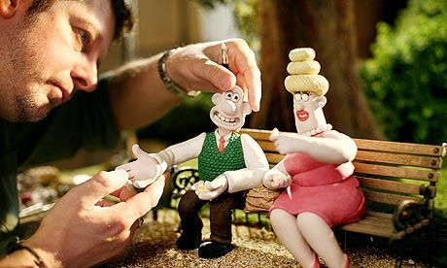
Bouncing ball
Animation technique: Stop Motion
Repeat:
Get into offscreen mode
Erase the ball
Compute the ball’s next position
Draw the ball in its next position
Show the new image
next
current
Notes:
apply a standard graphics technique to create the illusion of movement

Slide 20
Graphics: StdDraw API (partial)
static void circle(double x, double y, double radius)
static void clear()
static void enableDoubleBuffering()
static void filledCircle(x, y, radius);
static Color getBackgroundColor()
static Color getPenColor()
static void line(double x0, double y0, double x1, double y1)
static void pause(int t)
static void picture(double x, double y, String filename)
static void point(double x, double y)
static void rectangle(double x, double y, double halfWidth, double halfHeight)
static void save(String filename)
static void setCanvasSize(int canvasWidth, int canvasHeight)
static void setPenColor(int red, int green, int blue)
static void setPenColor(Color color)
static void setPenRadius(double radius)
static void setTitle(String title)
static void setXscale(double min, double max)
static void setYscale(double min, double max)
static void show()
static void square(double x, double y, double halfLength)
Complete API (click)
We’ll need the underlined functions

Slide 21
Bouncing balls
Implementation
public class BouncingBall {
public static void main(String[] args) {
// initializes the canvas to be a -1 by -1 square,
// and enables offscreen drawing.
StdDraw.setXscale(-1.0, 1.0);
StdDraw.setYscale(-1.0, 1.0);
StdDraw.enableDoubleBuffering();
// sets the ball's radius
double radius = 0.05;
// sets the ball's velocity (speed)
double vx = 0.015, vy = 0.023;
// initializes the ball's initial position (arbitrary point)
double x = 0.480, y = 0.860;
// main animation loop
while (true) {
//// next slide...
(-1, 1)
(1, 1)
(x, y)₂
(x, y)₃
(vx, vy)
(x, y)₁
(x, y)₀
(-1, -1)
2 by 2 canvas
(1, -1)

Slide 22
Bouncing balls
Implementation
public class BouncingBall {
public static void main(String[] args) {
// initializes the canvas and the ball’s values... (previous slide)
// main animation loop
while (true) {
// if the ball hits a wall, update the velocity
// according to law of elastic collision
if (Math.abs(x + vx) > 1.0 - radius) vx = -vx;
if (Math.abs(y + vy) > 1.0 - radius) vy = -vy;
// updates ball’s position
x = x + vx;
y = y + vy;
// clears the canvas, and re-draws the ball
StdDraw.clear(StdDraw.LIGHT_GRAY);
StdDraw.setPenColor(StdDraw.BLACK);
StdDraw.filledCircle(x, y, radius);
// copies offscreen buffer to onscreen buffer, and pauses briefly
StdDraw.show();
StdDraw.pause(20);
}
}
}
(-1, 1)
(1, 1)
(x, y)₂
(x, y)₃
(vx, vy)
(x, y)₁
(x, y)₀
(-1, -1)
(1, -1)

Slide 23
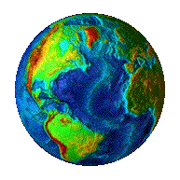

Bouncing balls
Special effects:
Instead of drawing a boring sphere, draw some image:
When hitting a wall, make a sound effect:
earth.gif
laser.wav
pop.wav
Implementation:
StdDraw.picture(x, y, "earth.gif"); // Draws the image at location (x, y)
StdAudio.play("laser.wav"); // Makes sounds

Slide 24

Bouncing balls
Special effects

Slide 25
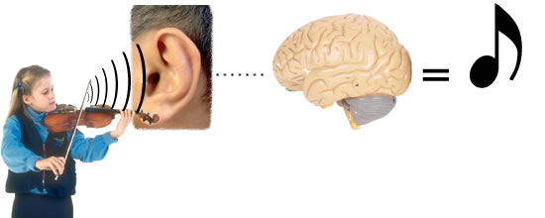
Lecture plan
Graphics
Animation
Sound
Note (תו)
Tone (צליל)

Slide 26
Sound
Sound
A perception in the brain caused by vibration of molecules hitting the eardrums
Note (תו)
Tone (צליל)
Tone (צליל): The sound’s pitch (wave frequency)
Note (תו): Selected pitch values are called notes
Tune (לחן): Combination of notes that sounds “right” to our brain.

Slide 27
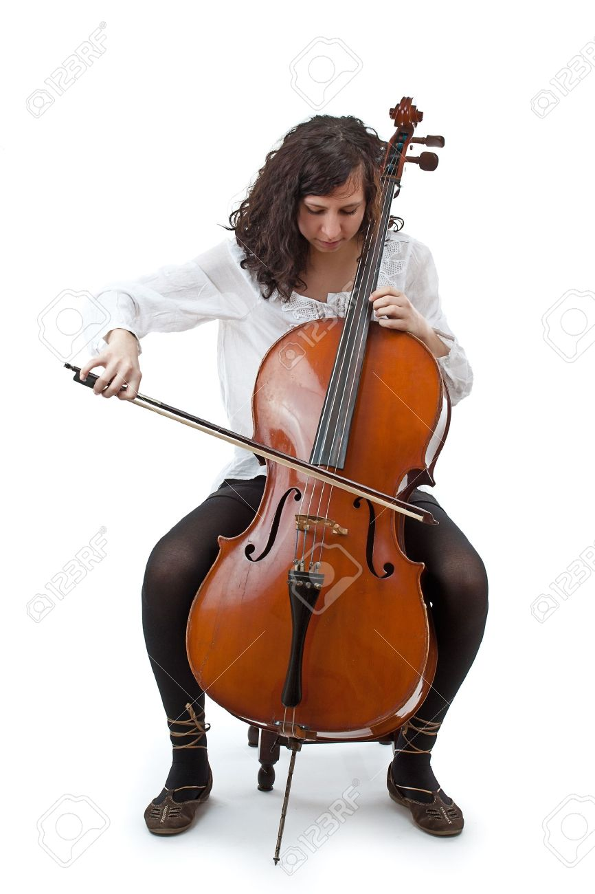
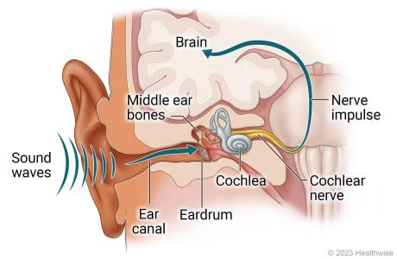



Sound crash course
lower frequency, lower pitch
higher frequency, higher pitch
Audible sensitivity:
humans: 20 - 20,000 Hz
dogs: 67 – 45,000 Hz
mice: 1 – 70,000 Hz
bats: 1 – 200,000 Hz
Pitch = frequency
(measured in Herz, number of cycles per second)

Slide 28
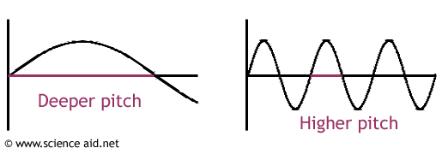
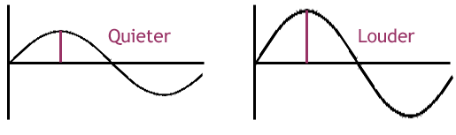
Sound crash course
Sound
Can be modeled using a sin(x) function with two properties:
Pitch
volume

Slide 29
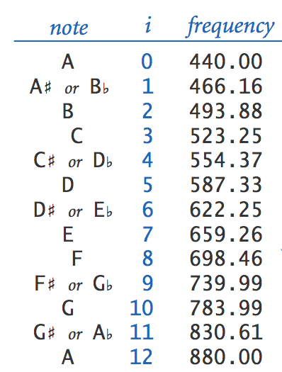
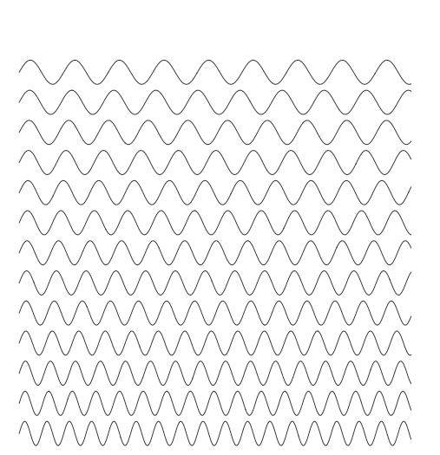
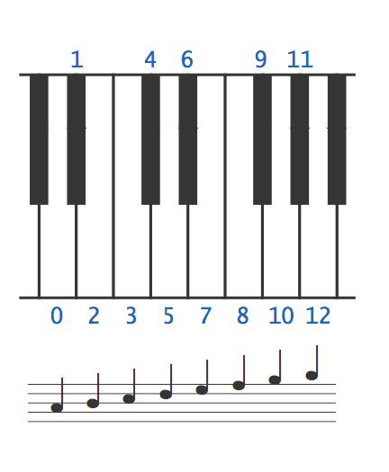
Chromatic scale
Selected 12 notes from 440 Hz to 880 Hz:
(pitch)
pitch(i) = 440 * 2 ^{i / 12}
% java Sound 523.25
(plays Do)
% java Sound 587.33
(plays Re)
% java Sound 659.26
(plays Mi)
Example
The note “concert-C” (middle Do) is represented by a sine wave, scaled to oscillate at 523.25 Hz (cycles per second)

Slide 30

Digitized sound
Using software to render sound by generating a sampled (digitized) sound wave

Slide 31
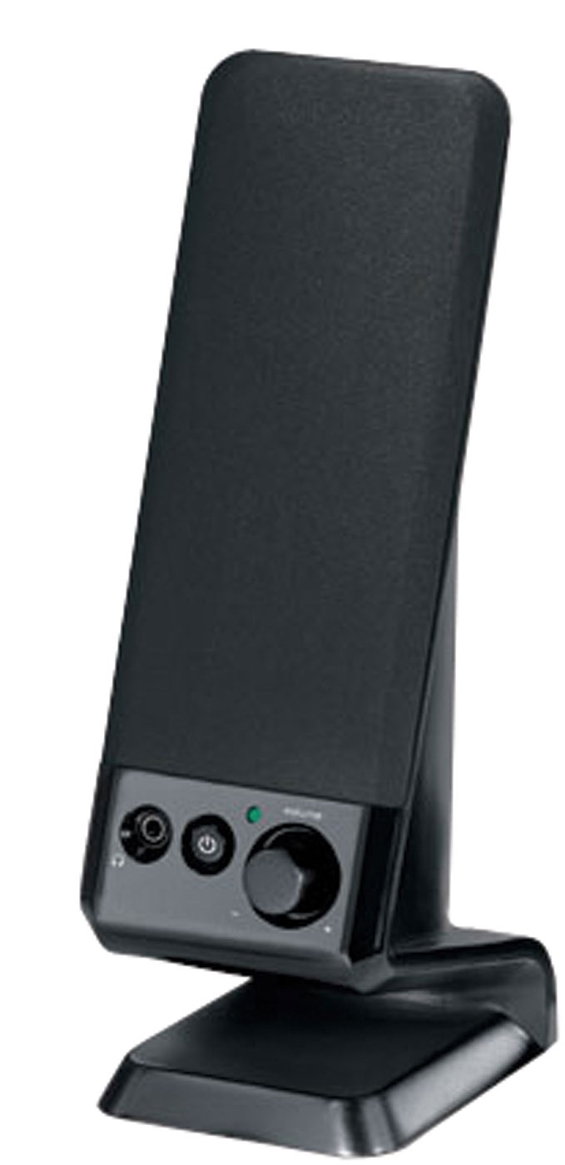
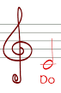
Digitized sound
Using software to render sound by generating a sampled (digitized) sound wave
The digitized sample is then played by the computer’s speakers
y: an array of values that approximates the sound wave function
y
StdAudio.play(arr)
X (time)
StdAudio.play(arr) sends the sequence of the array values to the audio driver, which controls the sound card (hardware), that controls the speakers
StdAudio = Sound library (Java)

Slide 32
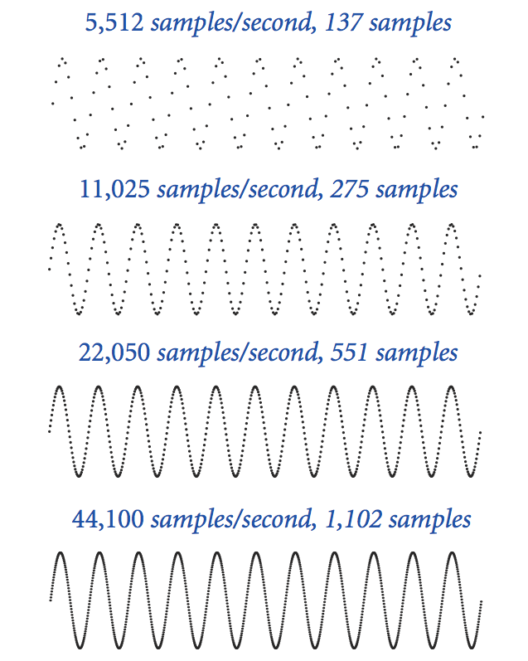
Sampling
1/40 second:
1/40 second:
Sampling rate (= “resolution”)
Number of samples per second (sps)
CD quality: Commonly used sampling rate, sps = 44100
1/40 second:
1/40 second:
Notes:
Analogous to the code we wrote to plot a function by sampling at a uniformly space set of points
now, we want to *play* the sine wave to a speaker instead of displaying it on the screen

Slide 33

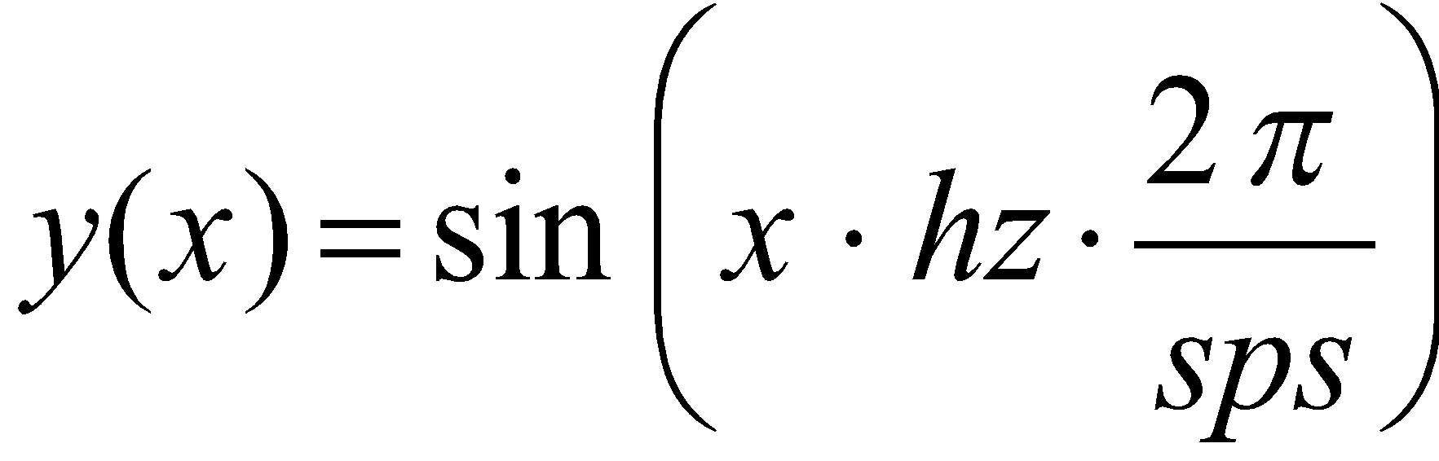
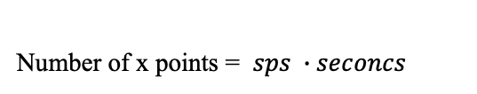
Playing tones (תדרים)
Example: Play a C note (hz = 523.25) for 2 seconds, sps (samples per second) = 44100
Implementation: Create an array (y) that samples the sine wave function, according to the given parameters, and then “play the array”, using the function call StdAudio.play(y)
abs
y
x = 0, 1, 2, 3, ...
0
1
2
3
4
5
6
7
...
x

Slide 34
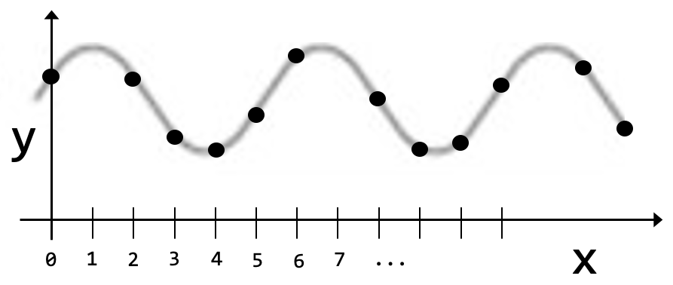
Playing tones (תדרים)
Example: Play a C note (hz = 523.25) for 2 seconds, sps (samples per second) = 44100
Implementation: Create an array (y) that samples the sine wave function, according to the given parameters, and then “play the array”, using the function call StdAudio.play(y)
// Returns an array representing a sampled sine wave modulated according
// to the given pitch (frequency, in Hz) and seconds, using a sampling
// rate of 44100 values per second.
public static double[] tone(double pitch, double seconds) {
int sps = 44100;
int N = (int) (seconds * sps);
double[] y = new double[N];
for (int x = 0; x < N; x++) {
y[x] = Math.sin(x * pitch * (2 * Math.PI) / sps);
}
return y;
}
}
x = 0, 1, 2, 3, ...

Slide 35
Playing tones (תדרים)
Example: Play a C note (hz = 523.25) for 2 seconds, sps (samples per second) = 44100
Implementation: Create an array (y) that samples the sine wave function, according to the given parameters, and then “play the array”, using the function call StdAudio.play(y)
// A library of functions for generating musical notes.
public class Sound {
public static void main(String[] args) {
double pitch = Double.parseDouble(args[0]);
// Creates a tone array representing the given pitch (frequency)
double[] tone = tone(pitch, 3); // plays it 3 seconds
StdAudio.play(tone);
}
// Returns an array representing a sampled sine wave modulated according
// to the given pitch (frequency, in Hz) and seconds, using a sampling
// rate of 44100 values per second.
public static double[] tone(double pitch, double seconds) {
int sps = 44100;
int N = (int) (seconds * sps);
double[] y = new double[N];
for (int x = 0; x < N; x++) {
y[x] = Math.sin(x * pitch * (2 * Math.PI) / sps);
}
return y;
}
}
x = 0, 1, 2, 3, ...
Plays some arbitrary tones:
% java Sound 8526
% java Sound 576
% java Sound 14365

Slide 36
Playing notes (תווים)
// A library of functions for generating musical notes.
public class Sound {
public static void main(String[] args) {
// Plays Do, Re, Mi, each for 0.5 second.
StdAudio.play(note(3, .5));
StdAudio.play(note(5, .5));
StdAudio.play(note(7, .5));
}
// Returns an array representing a sampled sine wave modulated according
// to the given pitch (frequency, in Hz) and seconds, using a sampling
// rate of 44100 values per second.
public static double[] tone(double pitch, double seconds) {
int sps = 44100;
int N = (int) (seconds * sps);
double[] y = new double[N];
for (int x = 0; x < N; x++) {
y[x] = Math.sin(x * pitch * (2 * Math.PI) / sps);
}
return y;
}
// Returns an array representing the given musical note, and seconds.
// (0 is A, 1 is A#, 2 is B, 3 is C, 4 is C#, ...).
public static double[] note(int i, double seconds) {
double pitch = 440.0 * Math.pow(2, i / 12.0);
return tone(pitch, seconds); // Computes the array (previous slide)
}
...
}
pitch(i) = 440 * 2^{i/12}
Plays Do Re Mi:
% java Sound 523.25
% java Sound 587.23
% java Sound 659.26

Slide 37
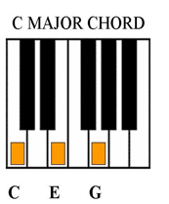
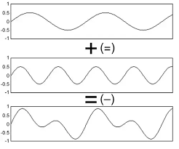
Playing chords (אקורדים)
abs
// Returns the weighted sum of two given arrays, using two given weights.
private static double[] sum(double[] a, double[] b, double awt, double bwt) {
double[] c = new double[a.length];
for (int i = 0; i < a.length; i++)
c[i] = awt * a[i] + bwt * b[i];
return c;
}

Slide 38
Playing chords (אקורדים)
// A library of functions for generating musical notes.
public class Sound {
public static void main(String[] args) {
// Plays the Do-major chord (Do, Mi and Sol), for 5 seconds
StdAudio.play(chord(3, 7, 10, 5));
}
// Tone and Note functions come here
// Returns the weighted sum of two given arrays, using two given weights.
private static double[] sum(double[] a, double[] b, double awt, double bwt) {
double[] c = new double[a.length];
for (int i = 0; i < a.length; i++)
c[i] = awt * a[i] + bwt * b[i];
return c;
}
// Returns a 3-note chord by combining the three given notes.
public static double[] chord(int i1, int i2, int i3, double seconds) {
double[] a1 = note(i1, seconds);
double[] a2 = note(i2, seconds);
double[] a3 = note(i3, seconds);
// builds and returns a mix of the three notes
double[] s = sum(a1, a2, .5, .5);
s = sum(s, a3, .5, .5);
return s;
}
}
abs

Slide 39
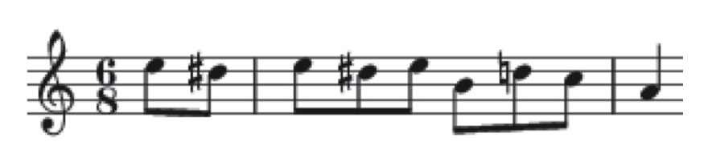
Playing tunes (לחנים)
Elise (Beethoven):
// A library of functions for generating musical notes.
public class Sound {
public static void main(String[] args) {
In in = new In(fileName);
while (!in.isEmpty()) {
int i = in.readInt();
double seconds = in.readDouble();
StdAudio.play(note(i, seconds));
}
}
// All other Sound functions come here
}
% more elise.txt
7 .3
6 .3
7 .3
6 .3
7 .3
2 .3
5 .3
3 .3
0 1.0
% java Sound elise.txt
(we’ll hear the first 9 notes of Elise)

